Slide 1
representing knowledge using Memory-augmented models
FMNLP, Fall 1401
Yadollah Yaghoobzadeh
University of Tehran
Most slides are from CS224N Kevin Guu slides

Slide 2
A major goal for AI: robustly reasoning with knowledge
AI researchers in the 1960s-80s already knew that domain knowledge was essential.
Famous expert systems:
INTERNIST-I → medical diagnosis
SID → computer chip design
Back then: manually input all knowledge as rules... way too much work, brittle.
Now: language models automatically acquire knowledge from the web.

Slide 3
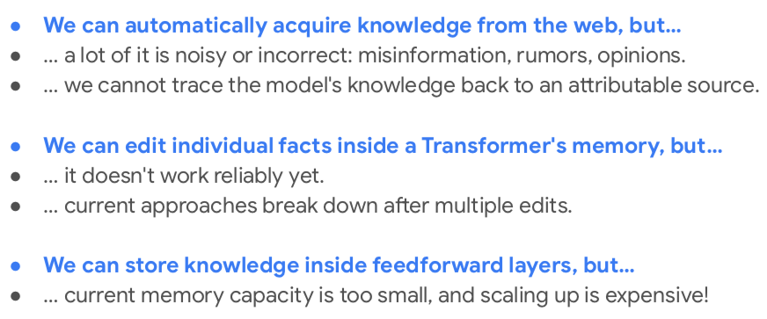
What is missing from Transformers right now?

Slide 4
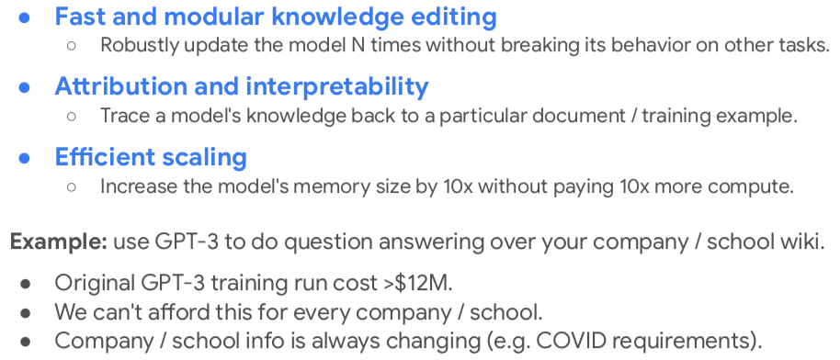
Wish list

Slide 6
memory-augmented models

Slide 7
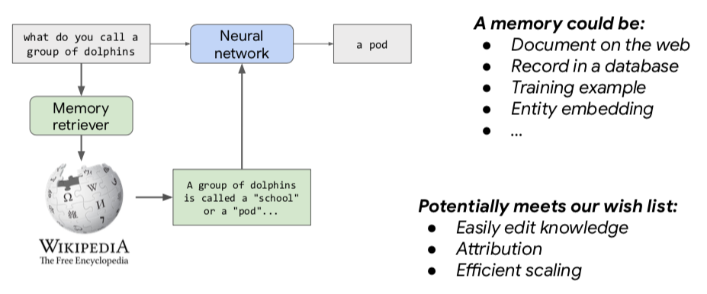
What is a memory-augmented model?

Slide 8
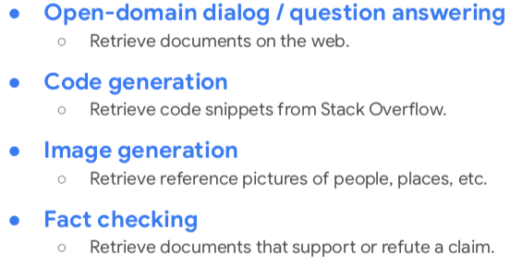
What are some applications?

Slide 9
Key design questions

Slide 10
How to retrieve memories?

Slide 11
Overview

Slide 12
Overview

Slide 13
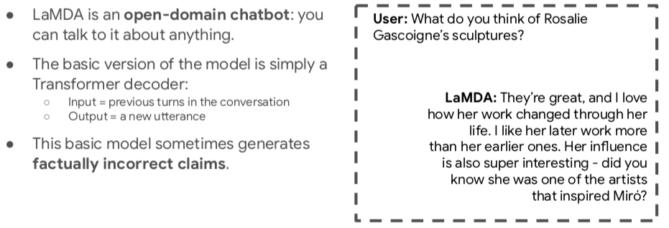
Using an external tool (LaMDA: Thoppilan et al, 2022)

Slide 14

Using an external tool (LaMDA: Thoppilan et al, 2022)

Slide 15
Using a search engine to improve factuality

Slide 16
Using a search engine to improve factuality

Slide 17
Using a search engine to improve factuality

Slide 18
Using a search engine to improve factuality

Slide 19
Using a search engine to improve factuality

Slide 20
Using a search engine to improve factuality

Slide 21
Modeling: Just treat everything as dialogue

Slide 22
Modeling: Just treat everything as dialogue

Slide 23
Modeling: Just treat everything as dialogue

Slide 24
Modeling: Just treat everything as dialogue

Slide 25
Main takeaways

Slide 26
Downsides of web search

Slide 27
Overview

Slide 28
Anatomy of neural retriever

Slide 29
Anatomy of neural retriever

Slide 30
Anatomy of neural retriever

Slide 31
Simplified setup

Slide 32
What are common retrieval functions?

Slide 33
What are common retrieval functions?

Slide 34
Training a neural retriever (supervised)

Slide 35
A concrete example (DPR Karpukhin et al, 2020)

Slide 36
How well does it work?

Slide 37
How well does it work?

Slide 38
Well, maybe just need to make T5 bigger?

Slide 39
What if we don’t have training data for retriever?

Slide 40
Overview

Slide 41
End-to-end learning

Slide 42
End-to-end learning

Slide 43
End-to-end learning

Slide 44
Intuitive idea (trial and error)

Slide 45
Formal idea (ORQA: Lee et al, 2019)

Slide 46
Formal idea

Slide 47
Formal idea

Slide 48
How well does it work?

Slide 49
A way to get countless (query, answer) pairs (REALM: Guu et al, 2020)

Slide 50
How well does it work?

Slide 51
Main takeaways

Slide 52
Can retrieval-augmented LMs improve other tasks?
From Umass Mohit Iyyer course, CS 685 Spring 2022

Slide 53
Nearest-neighbor machine translation

Slide 54
Nearest-neighbor machine translation

Slide 55
Nearest-neighbor machine translation

Slide 56
Nearest-neighbor machine translation

Slide 57
Nearest-neighbor machine translation

Slide 58
Nearest-neighbor machine translation

Slide 59
Interpolate between kNN prediction and decoder’s actual prediction

Slide 60
Increases translation quality

Slide 61
Can make it faster by using a smaller datastore

